Slide 1
StegaCrypt: Secure Image-Based Steganography
CAPSTONE PROJECT
Presented By:
Student Name : Manas Pratim Das
College Name & Department : Gauhati University Institute of Science and Technology, Department of Electronics and Communication Engineering
MTech (2nd Year)

Slide 2
OUTLINE
Problem Statement
Technology used
Wow factor
End users
Result
Conclusion
Git-hub Link
Future scope

Slide 3
Problem Statement
Secure Communication: Protecting sensitive data from unauthorized access over untrusted channels.
Encryption Vulnerabilities: Traditional encryption methods are prone to cryptographic attacks and interception.
Steganography for Security: Embedding data within images provides an additional layer of security by making detection difficult.
LSB-Based Data Hiding: The project utilizes Least Significant Bit (LSB) manipulation to conceal messages inside image pixels.
AES Encryption for Protection: Hidden messages are encrypted using AES to ensure confidentiality, even if extracted.
Enhanced Security & Undetectability: The combination of AES encryption and LSB steganography safeguards data from both detection and unauthorized access.
Real-World Applications: Useful for secure communication, digital watermarking, and preventing unauthorized information retrieval.

Slide 4
Technology used
Programming Language:
Python – Core language for implementing steganography and encryption.
Libraries & Frameworks:
OpenCV – Image processing and manipulation.
NumPy – Efficient handling of numerical operations.
Streamlit – Web-based UI for user interaction.
Cryptography (PyCryptodome/PyCrypto) – AES encryption for securing hidden messages.
Platforms & Tools:
Google Colab / Jupyter Notebook – For development and testing.
Streamlit Cloud / Local Server – Deployment of the application.
GitHub – Version control and project management.
Security Technologies Used:
Crypto – AES encryption for securing hidden messages.
hashlib – Password hashing for added security.
NumPy – Efficient numerical operations on image data.
base64 – Encoding and decoding encrypted messages.

Slide 5
Wow factors
AES Encryption for Enhanced Security – Unlike basic steganography, this project integrates AES encryption to secure hidden messages before embedding them into images.
Password-Based Protection – Implements password hashing to add an extra layer of security, ensuring only authorized users can decrypt the hidden message.
Optimized Pixel Manipulation – Uses OpenCV and NumPy for efficient and precise pixel-level modifications, minimizing visible distortions in the image.
Base64 Encoding for Data Integrity – Encodes encrypted messages using Base64, preventing corruption or loss of data during the embedding and extraction process.

Slide 6
End users
End Users of This Project
Cybersecurity Professionals – Can use this for secure communication and covert data transmission.
Journalists & Whistleblowers – Helps in securely sharing sensitive information without detection.
Forensic Experts – Assists in digital forensics and secure evidence storage.
General Users – Provides a simple and effective way to protect personal or confidential messages.

Slide 7
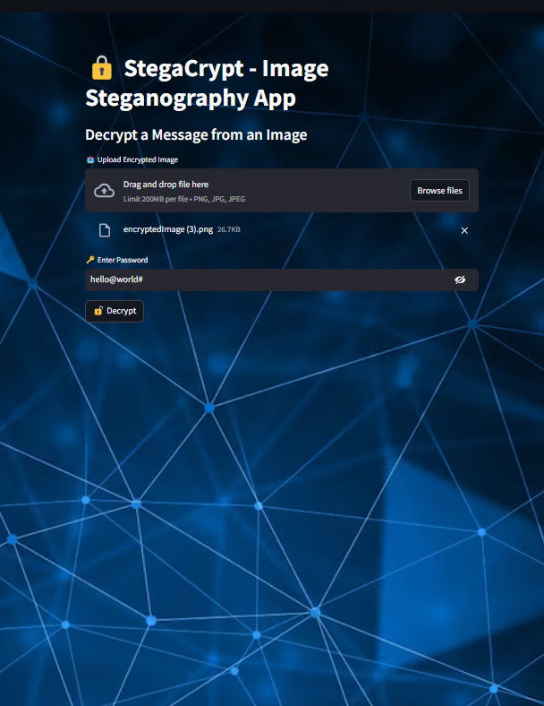
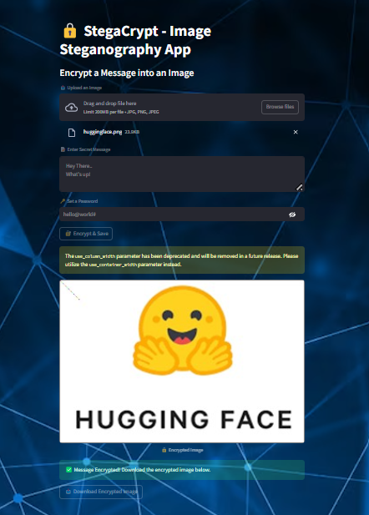
Results
Figures (i) and (ii) illustrate the encryption process using Streamlit, including interference handling and the option to download the image.
Fig. (i)
Fig. (ii)

Slide 8
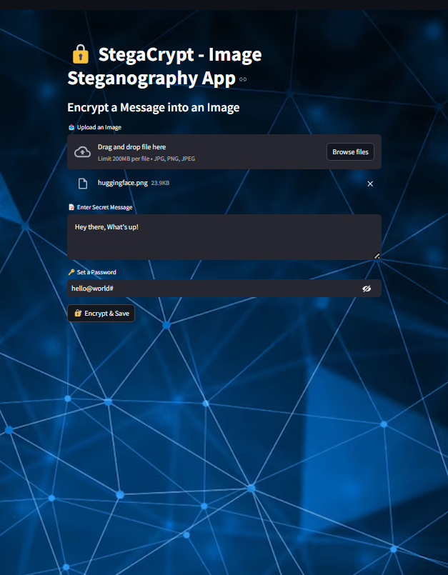
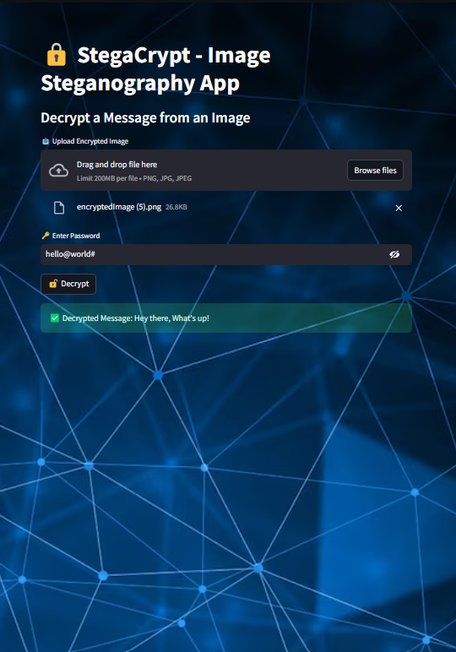
Results
Figures (iii) and (iv) depict the decryption process using Streamlit, showcasing interference handling and the option to view the encrypted data.
Fig. (iii)
Fig. (iv)

Slide 9
Conclusion
Implemented image steganography using Least Significant Bit (LSB) substitution, ensuring high security and imperceptibility.
The project successfully implements secure data hiding in images using AES encryption and LSB steganography.
Identified challenges such as compression resistance, noise robustness, and cryptographic security, suggesting areas for future enhancement.
Proposed future improvements, including deep learning-based steganography, adaptive embedding, and stronger encryption techniques, for enhanced security and efficiency.

Slide 10
GitHub Link
Repository: https://github.com/manas-pr/StegaCrypt-Secure-Image-Based-Steganography-Using-OpenCV-Streamlit
README File : https://github.com/manas-pr/StegaCrypt-Secure-Image-Based-Steganography-Using-OpenCV-Streamlit/blob/main/README.md
Live Project : https://stegacrypt-secure-image-based-steganography.streamlit.app/#a131f0cb

Slide 11
Future scope(optional)
Deep Learning-Based Steganography: Utilizing AI models like GANs and autoencoders to enhance security and undetectability.
Adaptive Embedding Techniques: Developing intelligent algorithms that adjust embedding based on image complexity to reduce distortion.
Cryptographic Integration: Combining steganography with encryption methods like AES or RSA for dual-layer security.
Robustness Against Attacks: Improving resistance to image processing operations such as compression, noise addition, and filtering.

Slide 12
THANK YOU

